Slide 1


SIVAP Intelligent System based on Machine Learning and Computer Vision for the Optimization of the Manufacturing Process of Porcelain
Romanian Research Ministry
BRIDGE GRANT – KNOWLEDGE TRANSFER TO AN ECONOMIC AGENT
UEFISCDI PN-III-P2-2.1-BG-2016-0333
Period of implementation: October 2016- October 2018

Slide 2
Program Challenges BRIDGE GRANT – KNOWLEDGE TRANSFER TO AN ECONOMIC AGENT
Program goal:
To increase the competiveness of economic agents by knowledge transfer from research institutes and universities
Objectives
To connect the expertise of universities with the economic agent necessities;
To accomplish student internships at the economic agent;
To develop entrepreneurial skills of researchers;

Slide 3
Project overview SIVAP Intelligent System based on Machine Learning and Computer Vision for the Optimization of the Manufacturing Process of Porcelain
What
Knowledge transfer project to IPEC to optimize the manufacturing process of porcelain.
How
An intelligent system based on machine learning and computer vision will optimize and innovate the current production flow.
Objectives
reducing the manufacturing time at each processing phase
optimizing the production efficiency by eliminating defective products
improving the monitoring and control system of the entire flow by adding new functionalities to the current computer vision system
increasing the innovation capacity of the economic agent.
Results
monitoring and quality control system implemented in real time and its integration into the company’s decision-making system
defects will be identified and classified at every operational phase.

Slide 4
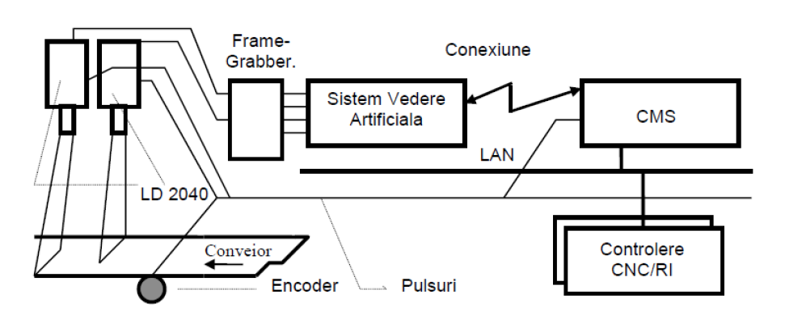
SIVAP Concept & Approach:
The optimized system will be based on the robot-computer vision architecture and will include:
real-time high-speed processing of product images
a global autonomous behaviour, context and task dependent self-learning that will be adaptive to the work environment

Slide 5
SIVAP – Expertise
Artificial intelligence:
Robotics
Machine learning
Computer vision
Stochastic modelling
System engineering
Multi-agent systems
Expert systems
Electronic systems

Slide 6
SIVAP Integrated in the Production Flow
SIVAP will be integrated in the production flow of porcelain as follows:
Step 1. Product reaches the inspection system;
Step 2. Product is illuminated + Sensor detects the product and sends a signal to the computing vision system;
Step 3. Computing Vision system receives the image from sensors;
Step 4. Various algorithms running on the artificial vision system process and analyze received images;
Step 5. Vision system sends signals to an industrial robot to remove the product if it is defective;
Step 6. Human operator analyses the acurracy of the rejected products and do statistics

Slide 7
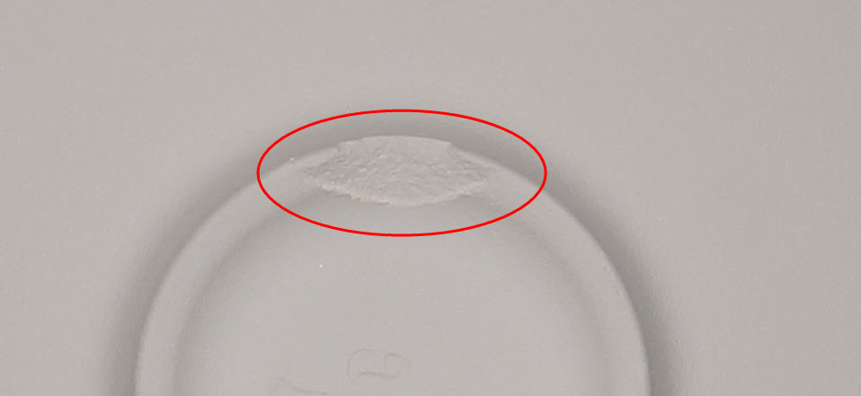
Defect detection with various algorithms implemented in Vision systems

Slide 8
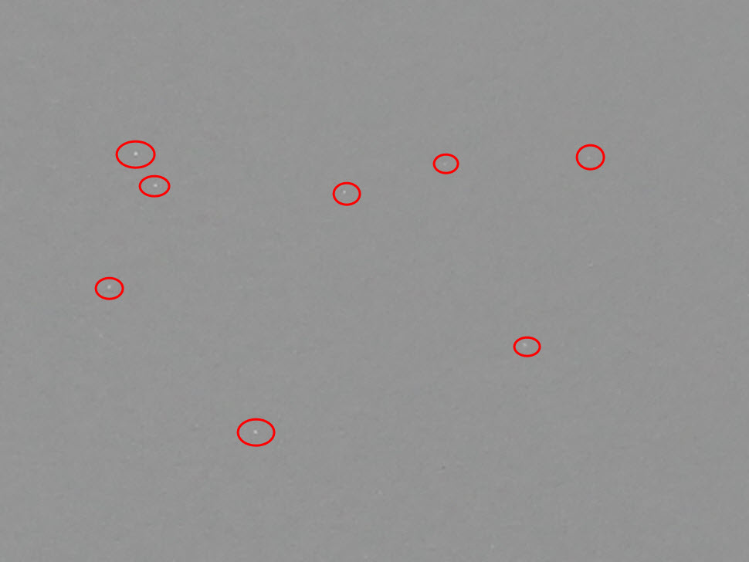
Defect detection with various algorithms implemented in Vision systems

Slide 9
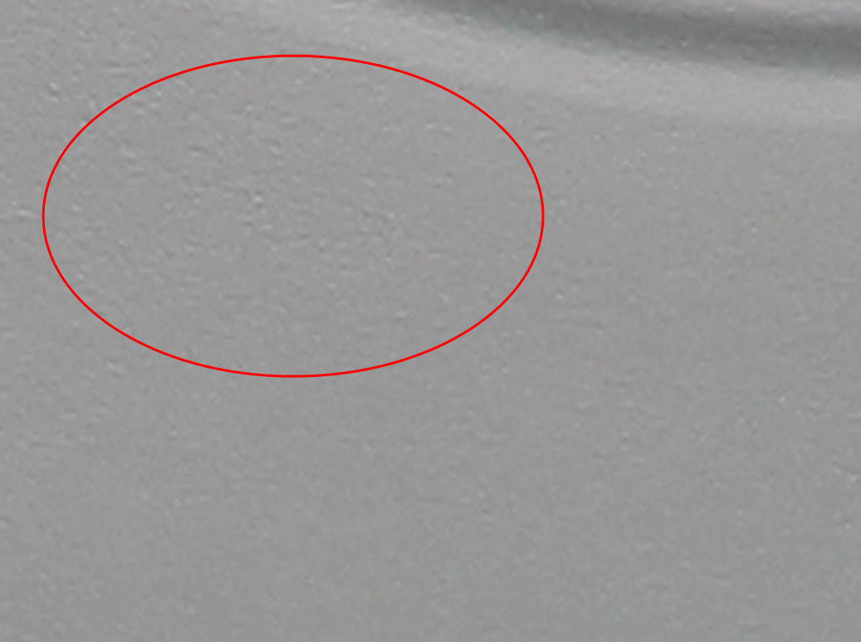
Defect detection with various algorithms implemented in Vision systems

Slide 10
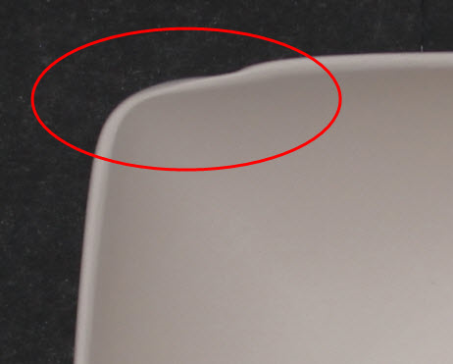
Defect detection with various algorithms implemented in Vision systems

Slide 11
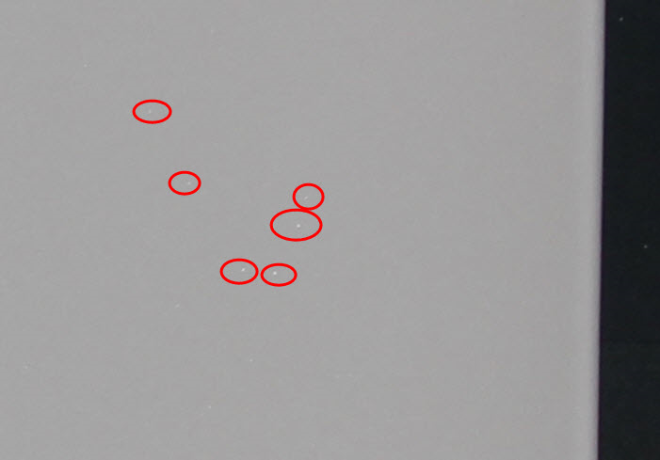
Defect detection with various algorithms implemented in Vision systems

Slide 12
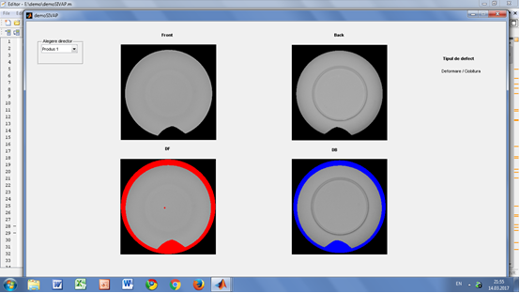
Automated comparison with standard product

Slide 13
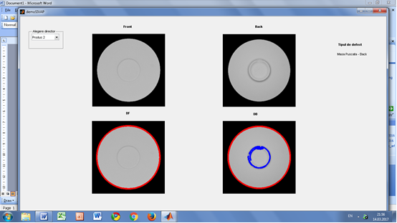
Automated comparison with a standard product

Slide 14
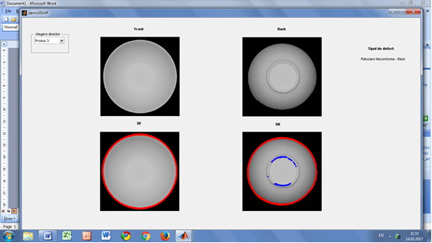
Automated comparison with a standard product

Slide 15
Future work
Automated recognition of defect type by machine learning and data mining techniques;
Increase of performance of existing 2D cameras by design and implementation of software for defect detection in the control system;
Increase of performance of existing 3D cameras by design and implementation of software for defect detection after burning of products;
New vision system architecture designed for the pressing phase and for final sorting of products;

Slide 16
Project team -UAB
Adriana Birlutiu, UAB – machine learning
Adrian Burlacu, Univ.Tehnică Gheorghe Asachi din Iaşi - computer vision
Santiago Garrido, Universitatea Carlos III Madrid – robotics
Manuella Kadar, UAB – multi-agent systems
Ricardo Jardim-Goncalves, New University of Lisbon – system interoperability
Adrian Tulbure, UAB – energy consumption
Gheorghe Marc, UAB – electronics
Angel Garrido, Universitatea UNED, Madrid – fuzzy systems
Lucian Popa, UAB – mathematical modelling
Mihai Oltean, UBB Cluj - robotics

Slide 17
Project team -IPEC
Cristian Covaciu – General Manager, Project Coordinator
Andrei Corb - computer vision & robotics
Adriana Giurcă – quality control

Slide 18


